Slide 1
Networking

Slide 2
Introduction
Java.net package
IP address
domain names
DNS

Slide 3
Protocols
Internet Protocol (IP)
is a low-level routing protocol that breaks data into small packets and sends them to an address across a network, which does not guarantee to deliver said packets to the destination.
Transmission Control Protocol (TCP)
is a higher-level protocol that manages to robustly string together these packets, sorting and retransmitting them as necessary to reliably transmit data.
A third protocol, User Datagram Protocol (UDP),
sits next to TCP and can be used directly to support fast, connectionless, unreliable transport of packets

Slide 4
Protocols
Java supports both stream-based and packet-based communications.
Stream-based communications use TCP for data transmission, whereas packet-based communications use UDP.
Since TCP can detect lost transmissions and resubmit them, transmissions are lossless and reliable.
UDP, in contrast, cannot guarantee lossless transmission.

Slide 5
Socket
Sockets are the endpoints of logical connections between two hosts and can be used to send and receive data.
Similar to I/O operations
client/server

Slide 6
Socket
A socket identifies an endpoint in a network (Berkely socket)
a socket allows a single computer to serve many different clients at once,
as well as to serve many different types of information
This is accomplished through the use of a port, which is a numbered socket on a particular machine.
A server process is said to “listen” to a port until a client connects to it

Slide 7
Port Numbers
Once a connection has been established, a higher-level protocol ensues, which is dependent on which port you are using
TCP/IP reserves the lower 1,024 ports for specific protocols.
Port number 21 is for FTP; 23 is for Telnet; 25 is for e-mail; 43 is for whois; 79 is for finger; 80 is for HTTP; 119 is for netnews—etc

Slide 8
Address
Every computer on the Internet has one. An Internet address is a number that uniquely identifies each computer on the Net
Originally, all Internet addresses consisted of 32-bit values, organized as four 8-bit values. IPv4 (Internet Protocol, version 4)
IPv6 uses a 128-bit value to represent an address, organized into eight 16-bit chunks
the name of an Internet address, called its domain name
An Internet domain name is mapped to an IP address by the Domain Naming Service (DNS).

Slide 9
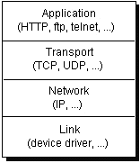
How it works
Computers running on the Internet communicate to each other using either the Transmission Control Protocol (TCP) or the User Datagram Protocol (UDP), as this diagram illustrates

Slide 10
java.net package
These classes provide system-independent network communication.
However, to decide which Java classes your programs should use, you do need to understand how TCP and UDP differ.

Slide 11
TCP or UDP?
Protocols using TCP are HTTP, FTP, Telnet etc
Protocols using UDP are DNS, SNMP(Simple Network Management Protocol), DHCP( Dynamic Host Configuration Protocol), Routing Information Protocol(RIP)

Slide 12
How is data transmitted?
Generally speaking, a computer has a single physical connection to the network
So how does the computer know to which application to forward the data?
Ports

Slide 13
What are Ports? Cont…
Data transmitted over the Internet is accompanied by addressing information that identifies the computer and the port for which it is destined.
The computer is identified by its 32-bit IP address, which IP uses to deliver data to the right computer on the network.
Ports are identified by a 16-bit number, which TCP and UDP use to deliver the data to the right application.

Slide 14
What are Ports? Cont…
In connection-based communication such as TCP, a server application binds a socket to a specific port number.
This has the effect of registering the server with the system to receive all data destined for that port. A client can then rendezvous with the server at the server's port, as illustrated here:

Slide 15

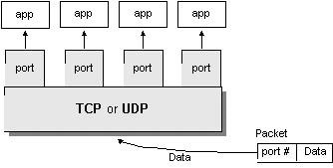
What are Ports? Cont…

Slide 16
Port Numbers
Port numbers range from 0 to 65,535 because ports are represented by 16-bit numbers.
The port numbers ranging from 0 - 1023 are restricted; they are reserved for use by well-known services such as HTTP and FTP and other system services.
These ports are called well-known ports. Your applications should not attempt to bind to them.

Slide 17
InetAddress
The InetAddress class is used to encapsulate both the numerical IP address and the domain name for that address.
You interact with this class by using the name of an IP host, which is more convenient and understandable than its IP address.
The InetAddress class hides the number inside.
InetAddress can handle both IPv4 and IPv6 addresses.

Slide 18
Factory Methods
The InetAddress class has no visible constructors
Factory methods are merely a convention
whereby static methods in a class return an instance of that class.

Slide 19
Factory methods
static InetAddress getLocalHost( ) throws UnknownHostException
static InetAddress getByName(String hostName) throws UnknownHostException
static InetAddress[ ] getAllByName(String hostName) throws UnknownHostException
getByAddress( ), which takes an IP address and returns an InetAddress object.

Slide 20
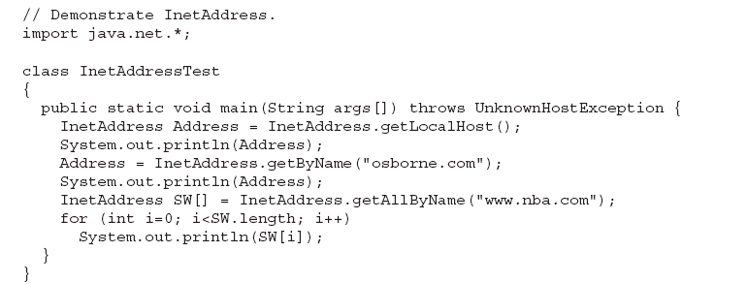
Example

Slide 21
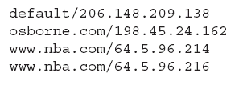
Example Output

Slide 22
TCP/IP Client Sockets
The ServerSocket class is designed to be a “listener,” which waits for clients to connect before doing anything.
ServerSocket is for servers
The Socket class is for clients.

Slide 23
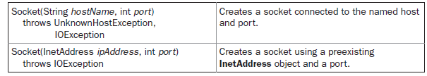
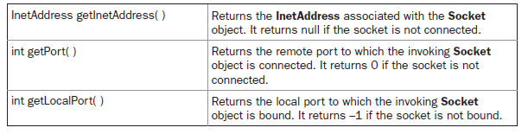
Socket class

Slide 24
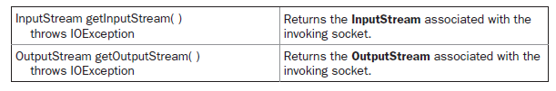
Socket class

Slide 25
TCP/IP Server Sockets
The ServerSocket class is used to create servers that listen for either local or remote client programs to connect to them on published ports
When you create a ServerSocket, it will register itself with the system as having an interest in client connections.
The constructors for ServerSocket reflect the port number that you want to accept connections on and, optionally, how long you want the queue for said port to be
The default is 50
The constructors might throw an IOException under adverse conditions

Slide 26
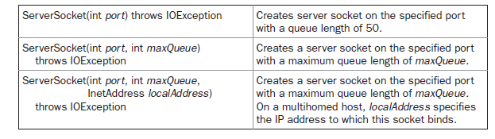
ServerSocket

Slide 27
ServerSocket
ServerSocket has a method called accept( ), which is a blocking call that will wait for a client to initiate communications and then return with a normal Socket that is then used for communication with the client.

Slide 28
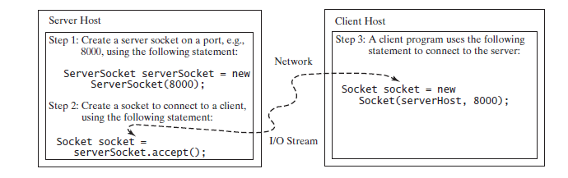
Connecting to the server
Socket socket = new Socket("130.254.204.33", 8000)
Socket socket = new Socket("liang.armstrong.edu", 8000);
JVM asks the DNS to translate the host name into the IP address.
Socket socket = new Socket(InetAddress.getLocalHost(), 8000);

Slide 29
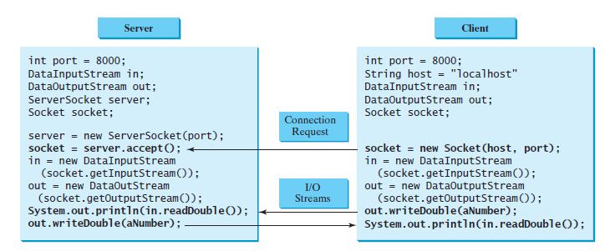
InputStream input = socket.getInputStream();
OutputStream output = socket.getOutputStream();

Slide 30
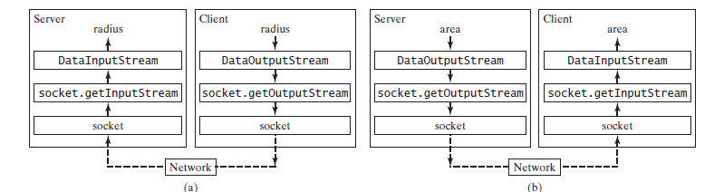

Slide 31
DataInputStream & DataOutputStream
DataInputStream, DataOutputStream, BufferedReader, and PrintWriter to wrap on the InputStream and OutputStream to read or write data, such as int, double, or String
The java.io.DataInputStream class lets an application read primitive Java data types from an underlying input stream in a machine-independent way

Slide 32
TCP overhead
provides a serialized, predictable, reliable stream of packet data
complicated algorithms for dealing with congestion control on crowded networks
pessimistic expectations about packet loss

Slide 33
Datagrams
Datagrams are bundles of information passed between machines
DatagramPacket object is the data container, while the DatagramSocket is the mechanism used to send or receive the DatagramPackets

Slide 34
DatagramSocket
DatagramSocket( ) throws SocketException
DatagramSocket(int port) throws SocketException
DatagramSocket(int port, InetAddress ipAddress) throws SocketException

Slide 35
DatagramSocket:methods
void send(DatagramPacket packet) throws IOException
void receive(DatagramPacket packet) throws IOException

Slide 36
DatagramPacket
DatagramPacket(byte data [ ], int size)
DatagramPacket(byte data [ ], int offset, int size)
DatagramPacket(byte data [ ], int size, InetAddress ipAddress, int port)
DatagramPacket(byte data [ ], int offset, int size, InetAddress ipAddress, int port)

Slide 37
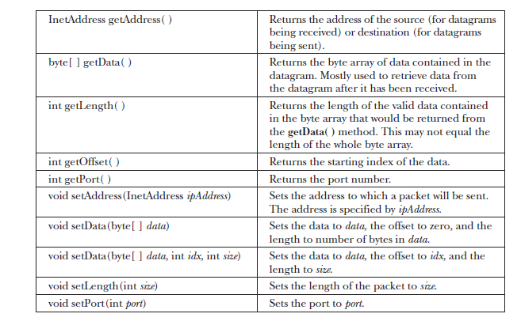

Slide 38
URL class
URL object
The 4 components of a URL object
URLConnection and extract the following
response date and time
Content type
Expiration date
Last modified
Get content length
Download content

Slide 39
HttpURLConnection
Cast URLConnection to HttpURLConnection and extract the following
Request method
Response code and response message
Get a set of the header fields and their values

